Slide 1
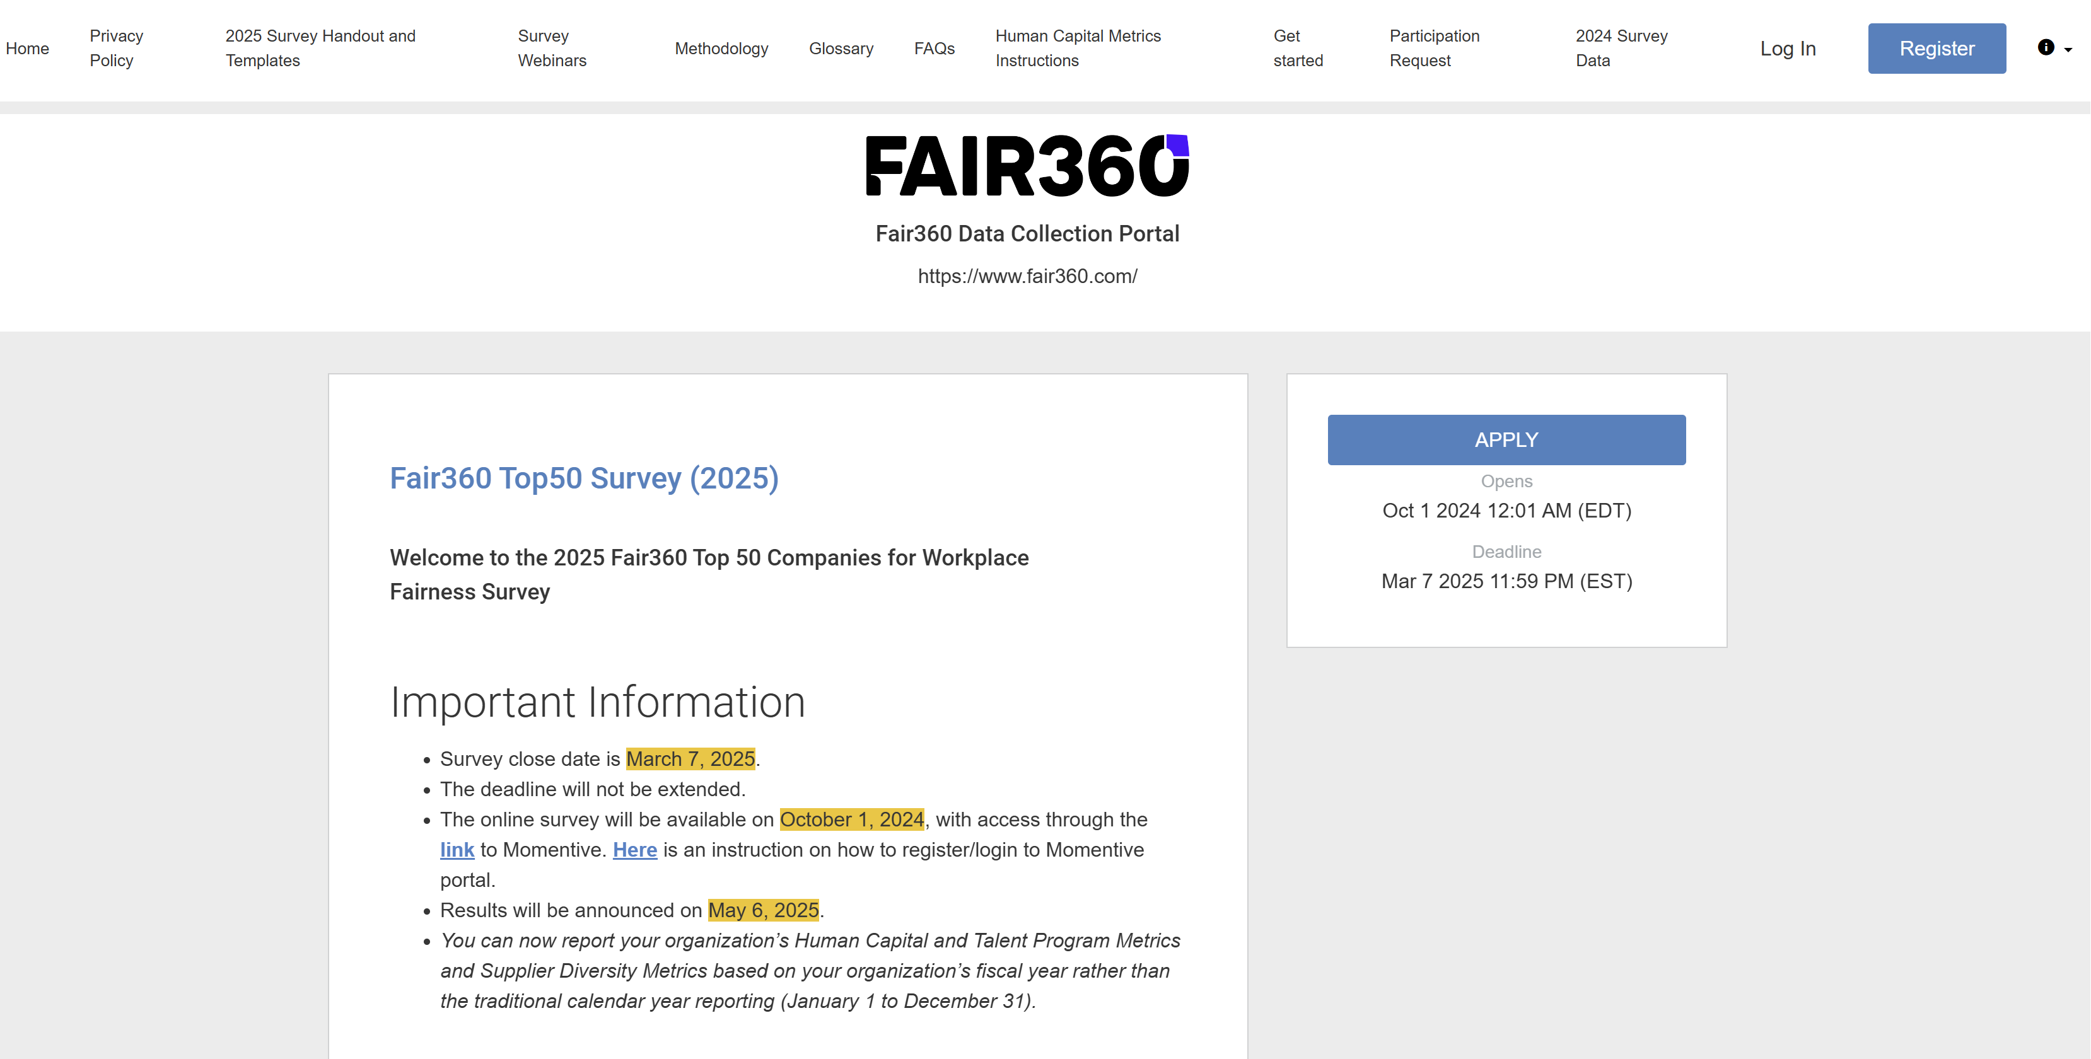
Step 1
2. If you are a returning participant, click on “Apply” and then login using your previous credentials, which direct you to step 5.*
1. Register if it’s your first attempt at completing the survey.
* Note: If you are a returning participant and log in before clicking the "Apply" button, you will be directed to a page displaying your last year's application. To access the new 2025 survey, simply click on "Programs" in the top right navigation bar, then click on "Apply," which will take you to step 5.
1

Slide 2
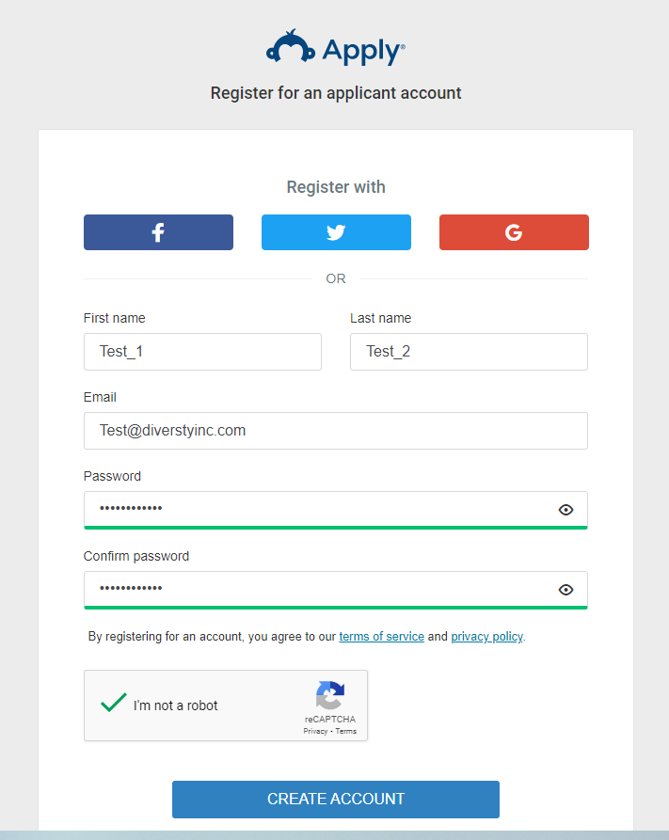
Step 2
Enter the submitter’s info and then create an account for your organization
2

Slide 3
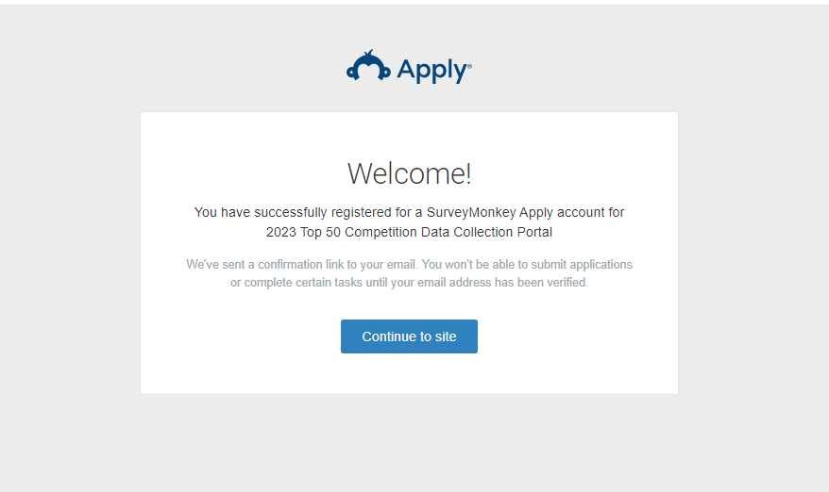
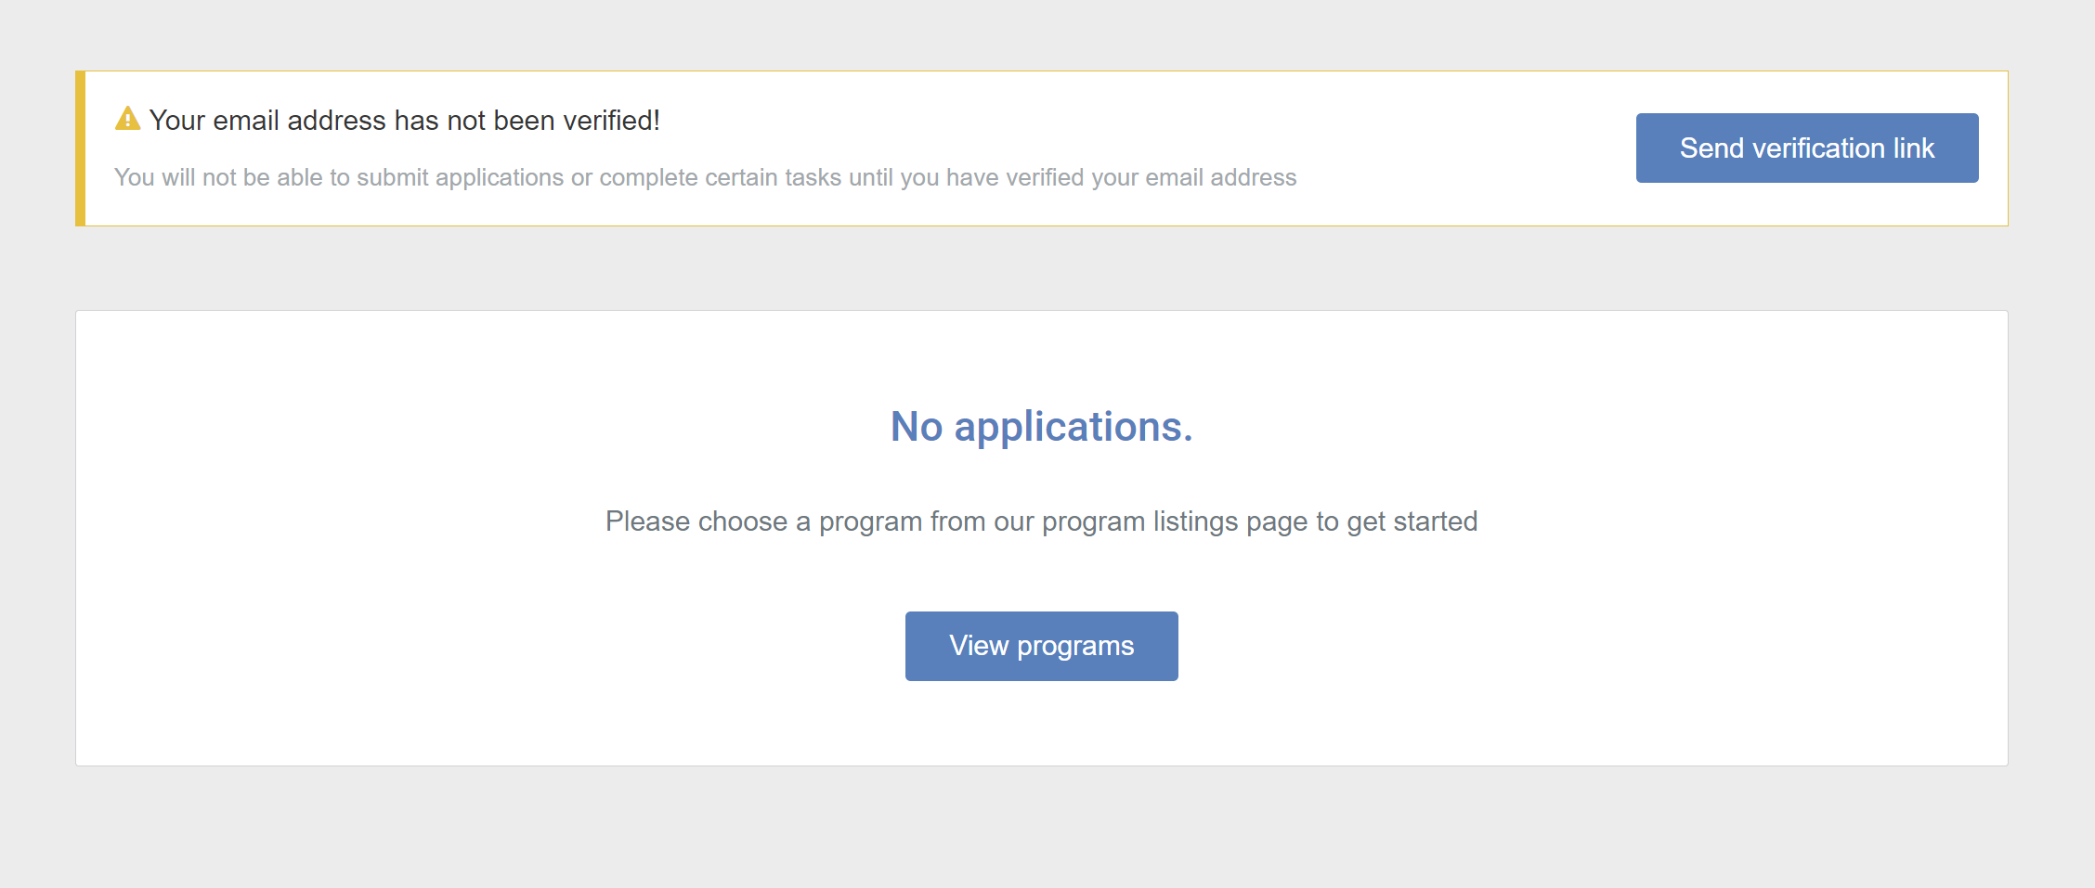
Step 3
1. Click here
2. Verify your email
3. Then click here
3

Slide 4
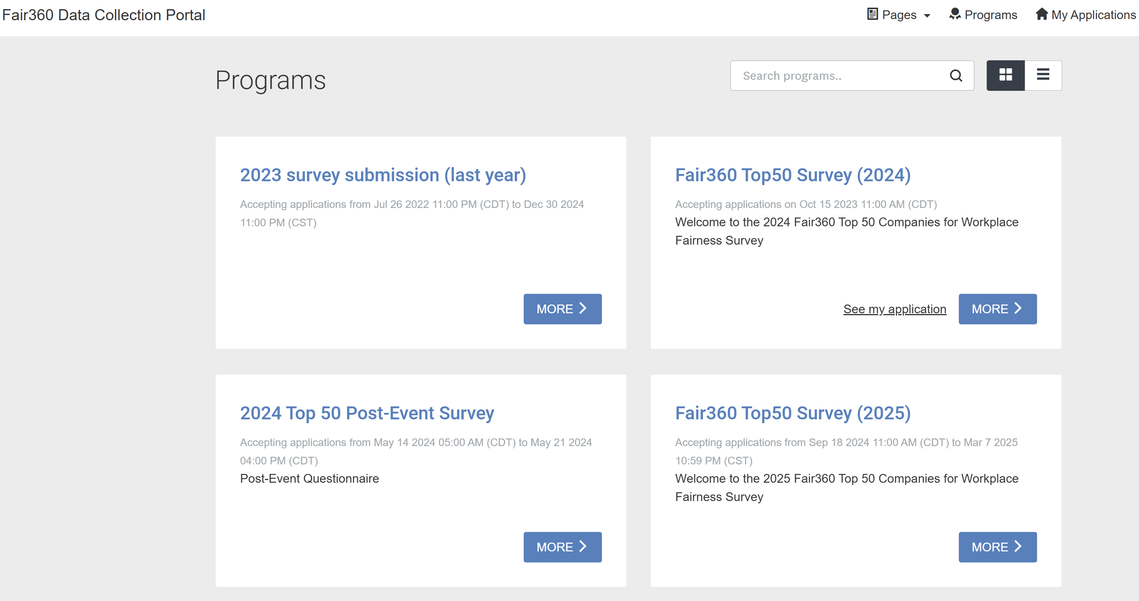
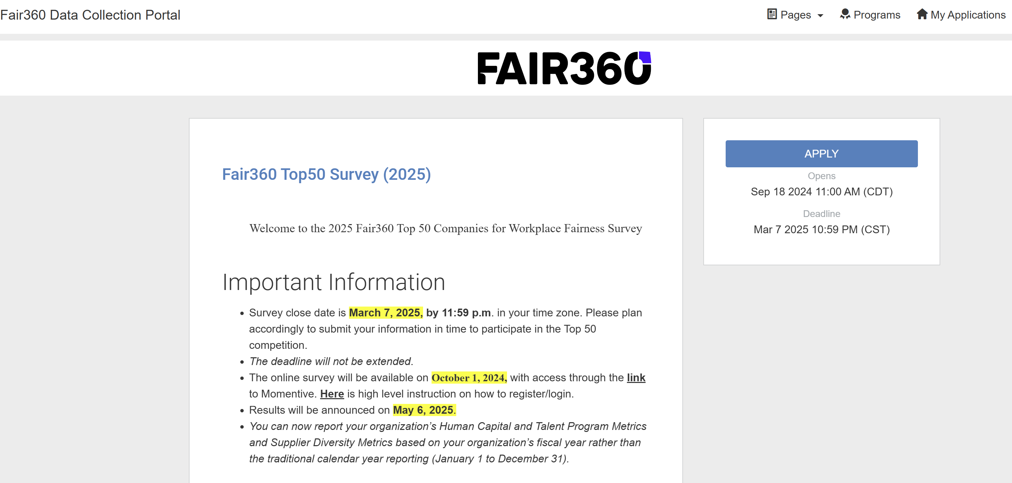
Step 4
1. Choose the survey you’d like to fill out. For example: Fair360 Top50 Survey (2025)
2. Then click here on APPLY button
4

Slide 5
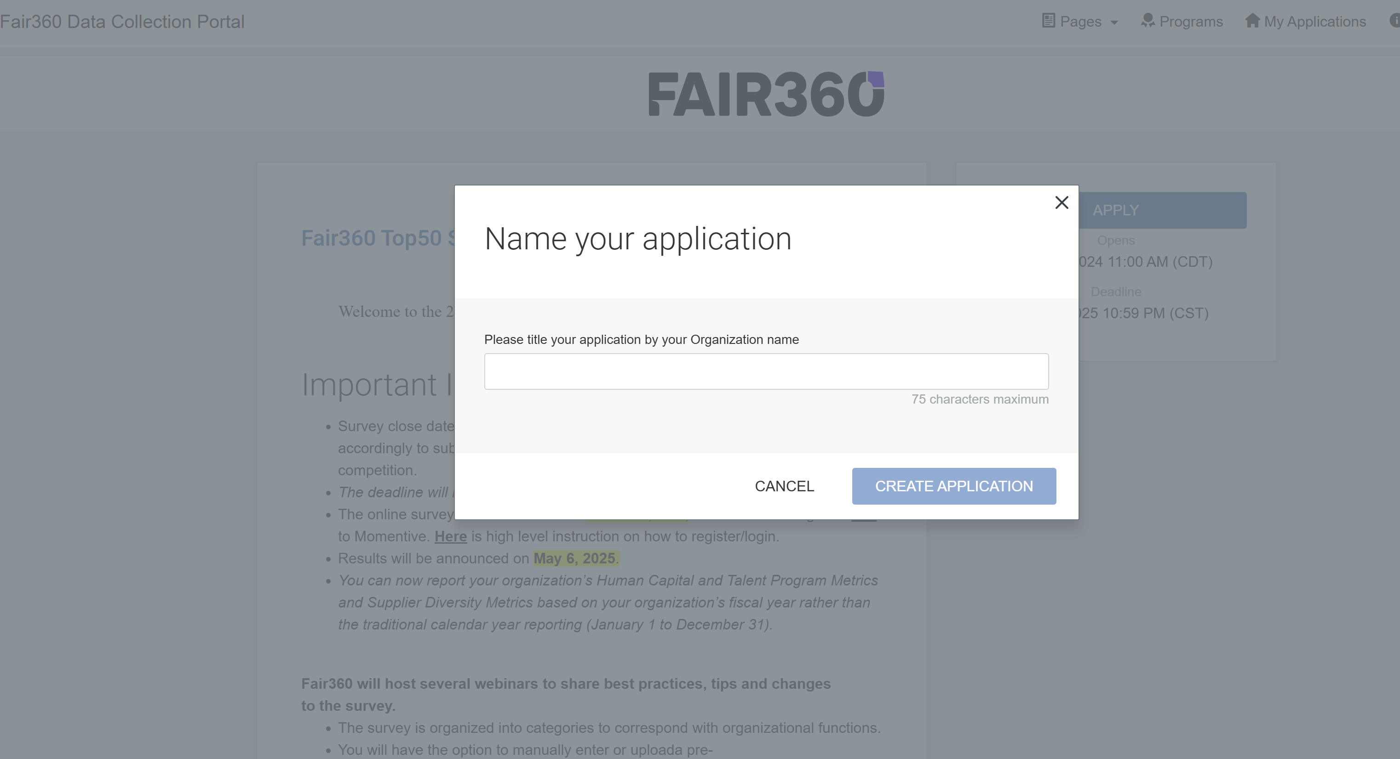
Step 5
Enter your organization title and then create the application
5

Slide 6
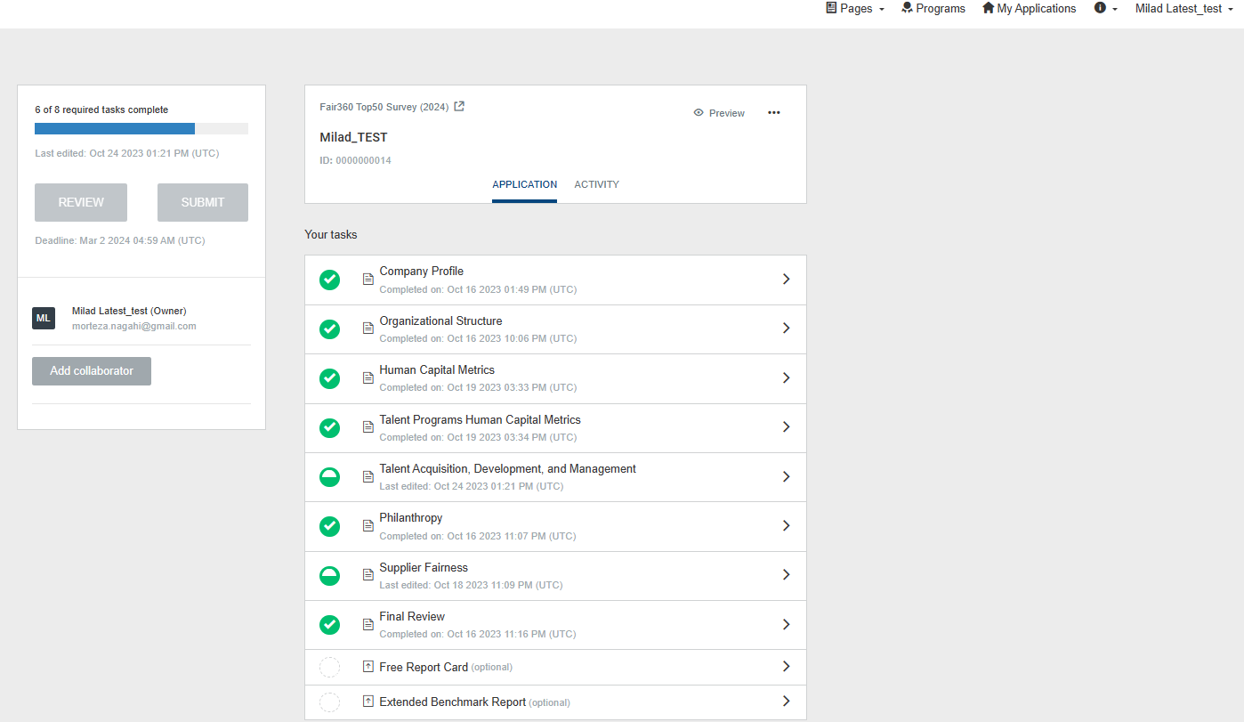
Step 6
3. Useful information regarding our Methodology, Policy, FAQs, Instruction, etc.
2. You can access your credentials and application status in top toolbar
1. You can start inserting data in the survey sections
6

Slide 7
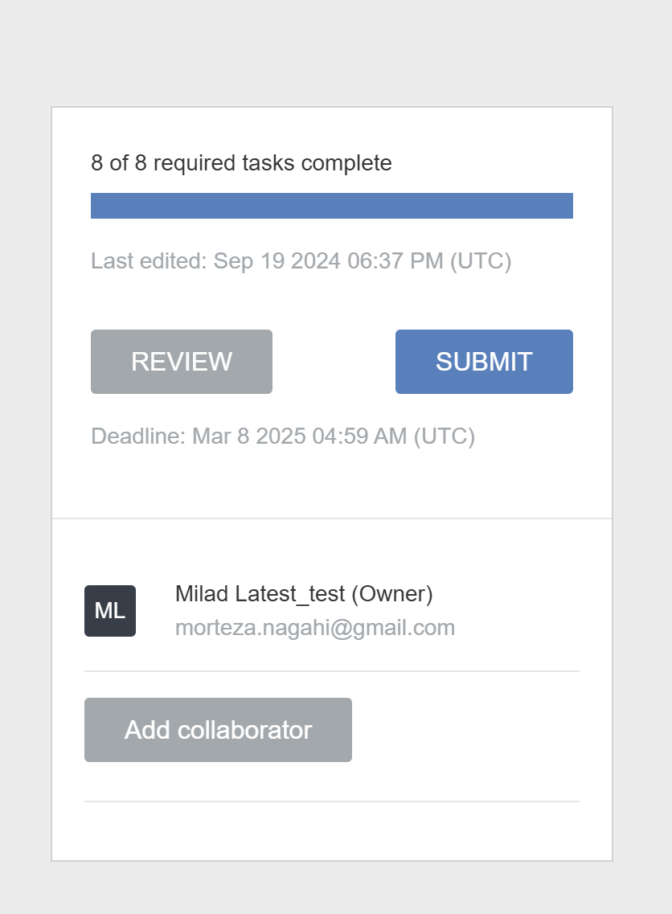
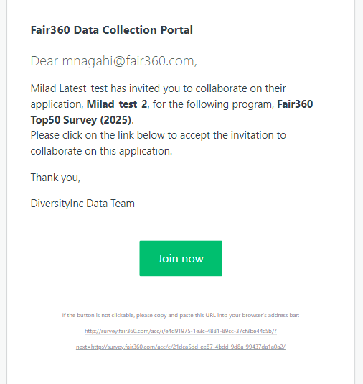
Step 7
1. You can invite collaborators
ABC Inc.
2. Use collaborators’ email for invitation and define the type of access (you can change/ revoke the granted access any time)
3. Collaborators can join through the provided link
7

Slide 8
Questions? Please email us at top50@fair360.com
8

Slide 9
Questions? Please email us at top50@fair360.com support@fair360.com
9

